Slide 1
Modified Booth’s Algorithm
Ushus E Zachariah

Slide 2
Overview
Recap – Booth’s Multiplication Algorithm
Modified Booth Algorithm

Slide 3
Booth’s Multiplication Algorithm
Multiplier
V
ersion of multiplicand
selected by bit
i
Bit
i
Bit
i
-
1
0
0
0
X
M
0
1
+
1
X
M
1
0
−
1
X
M
1
1
0
X
M
Booth multiplier recoding table.

Slide 4
Example
0
1
1
0
1
(
+
13
)
0
1
1
0
1
X
1
1
0
1
0
(
-
6
)
0
-
1
+1
-
1
0
0
0
0
0
0
0
0
0
0
0
1
1
1
1
1
0
0
1
1
0
0
0
0
1
1
0
1
1
1
1
0
0
1
1
0
0
0
0
0
0
1
1
1
0
1
1
0
0
1
0
(
-
78
)
Booth multiplication with a negative multiplier.

Slide 5


Bit Pair recording of Multipliers (Modified Booths Algorithm )
-1 | +1 | -1 | 0
 |  | -2
1
1
1
0
1
0
0
0
0
−
1
+
1
−
1
0
0
−
1
−
2
(a) Example of bit-pair recoding derived from Booth recoding

Slide 6
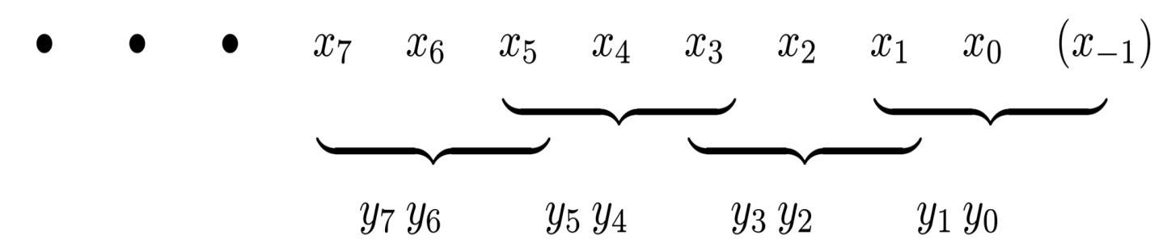
Modified Booths Algorithm
Guarantees that the maximum number of summands that must be added is n/2 for n-bit operands.
Bit pair recoding technique
Observe the following:
The pair (+1, -1) is equivalent to the pair (0, +1)
(+1, 0) is equivalent to (0, +2)
(-1, +1) is equivalent to (0, -1)
Examines 3 bits at a time.

Slide 7
Example
Convert the Following Multiplier bits in to Modified Booth Recording Formats
00101
11001
00111

Slide 8
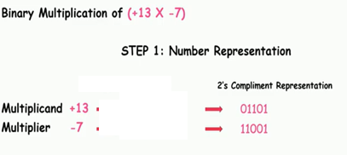
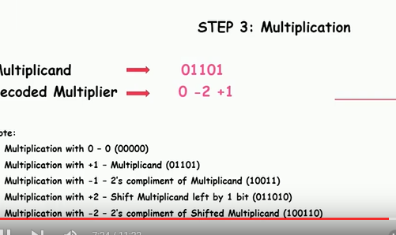
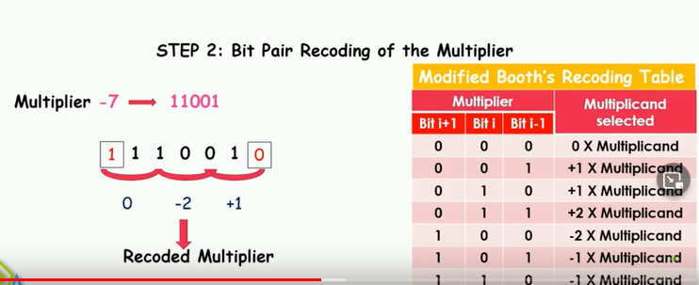
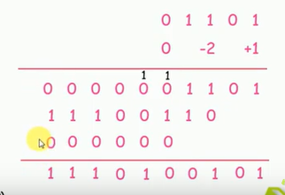

Slide 9
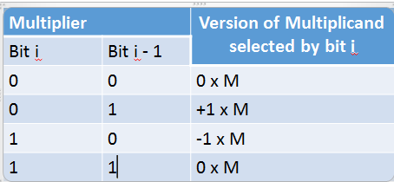
Bit PAIR Recording TABLE
Multiplier Bit-Pair |  | Multiplier bit on the right i – 1 | Booth’s Repres-enation |  | Multiplicand selected at position i
i + 1 | i
0 | 0 | 0 |  |  | 0 x M
0 | 0 | 1 |  |  | + 1 x M
0 | 1 | 0 |  |  | +1 x M
0 | 1 | 1 |  |  | + 2 x M
1 | 0 | 0 |  |  | - 2 x M
1 | 0 | 1 |  |  | - 1 x M
1 | 1 | 0 |  |  | -1 x M
1 | 1 | 1 |  |  | 0 x M
Reference; I Malaserene & Saritha V

Slide 10
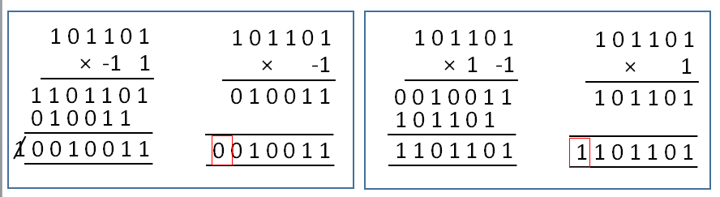
Modified Booth’s Algorithm

Slide 11
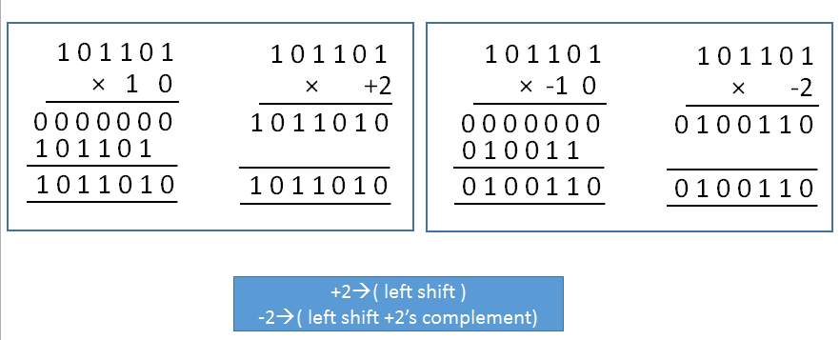
Modified Booth’s Algorithm
Insert zero after left shifting

Slide 12

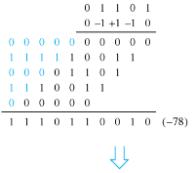
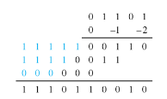
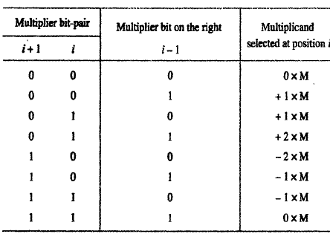
Multiplication requiring only n/2 summands
1 1 1 0 1 0 0
0
-1
-2
+2→( left shift )
-2→( left shift +2’s complement)

Slide 13
multiplier
1) 110110 2) 101100=[-1 , -1, 0] 3) 011011=[+2, -1, -1] | Bit pair recording format for the multiplier
1 | 1 | 0(Qn+1) | 1 | 1 | 0 | 0
10110(Qn=1) 0(Qn+10 |  | -1 | -1 | 0
-1 |  | +2 |  | -2

Slide 14
Modified Booth’s Multiplication - Example
Example: -9 × -13 = 117
M = 110111, M + 1 = 001001
Comment
A
Q
Q ₋₁
SC
000000
110011
0
3
Subtract M
001001
001001
Ashr
000100
111001
1
Ashr
000010
011100
1
2
Add M
110111
111001
Ashr
111100
101110
0
Ashr
111110
010111
0
1
Subtract M
001001
000111
Ashr
000011
101011
1
Ashr
000001
110101
1
0

Slide 15
References
Text Book
William Stallings “Computer Organization and architecture” Prentice Hall, 7th edition, 2006
Carl Hamacher, Zvonko Vranesic, Sofwat Zaky, “Computer Organization”, 5th edition, Mc Graw Hill.

Slide 16
1)A= 010111(Multiplicand)
B= 110110(multiplier)
2)
A=110011
B= 101100
3)
A=110101
B=011011

Slide 17
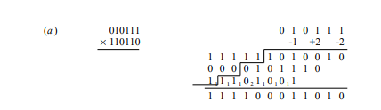

Slide 18
